Slide 1

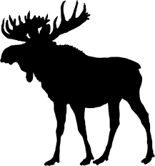



Collecting wildlife survey data (and what to do with all that data)
Kevin Shoemaker, Associate Professor
Wildlife Ecology and Conservation Major
Natural Resources and Environmental Science
Notes:
Starting off- what is wildlife? Are small mammals wildlife, are spiders wildlife? Are fish wildlife (if so then why there departments of fish and wildlife?)? Are mosquitoes wildlife? Are plants wildlife? Are viruses wildlife?
Saunder’s veterinary dictionary: Animals running unrestrained in a natural environment. Contrasts with my tortosies that spend their lives in burrows.

Slide 2
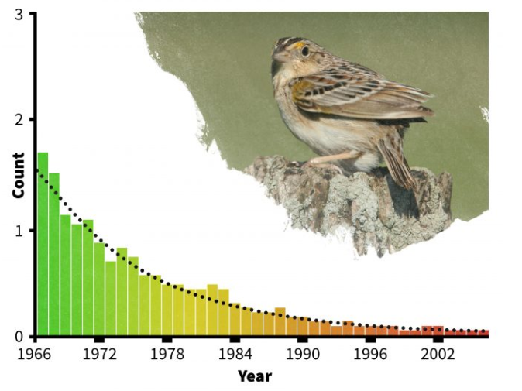
Why survey wildlife?
Determine conservation status
Are populations declining?
Help managers make decisions
Adaptive harvest management
Identify critical habitat areas
Gauge population response to:
Management actions
Disturbance (e.g., fire)
Advance scientific understanding!
Study community assembly over time, ecosystem response to global change, etc.
Snapshot of biodiversity and ecosystem health (“Bio-blitz”)

Slide 3
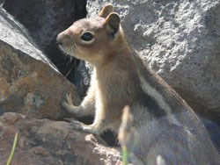
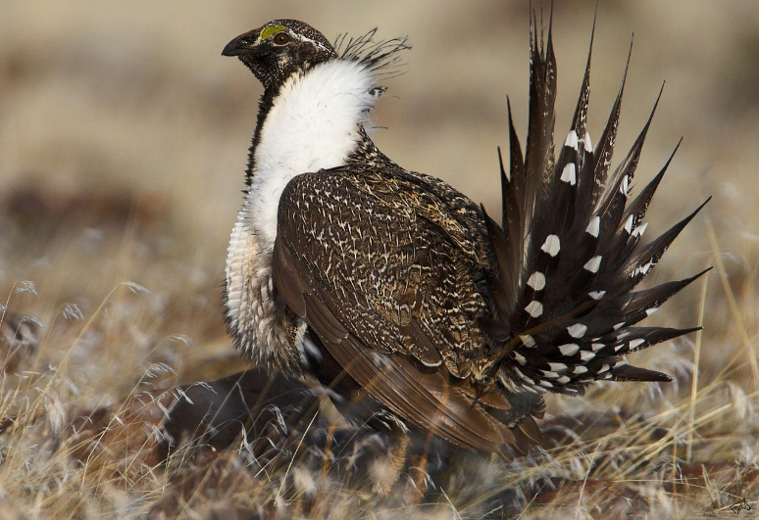
Counting animals sounds easy…
Imperfect/incomplete counts
Impossible to count them all!
Impractical to cover all parts of the range
Hard to detect rare events like dispersal
Difficult to observe activities year round
Difficult to observe at night!
Difficult to capture and mark
Animals don’t want to be seen
Animals REALLY don’t’ want to be handled!

Slide 4
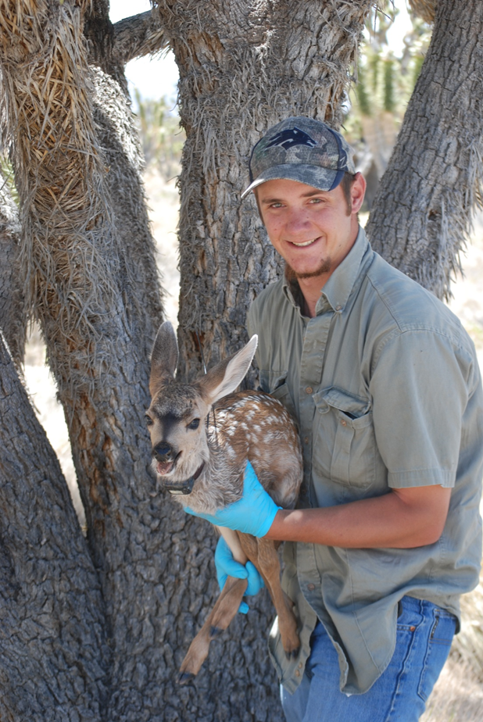
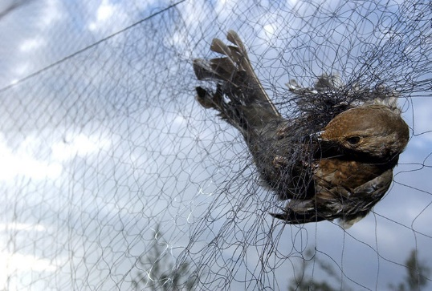
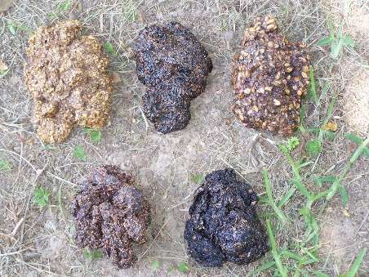
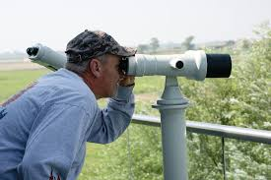
Types of wildlife surveys
Observational
Indirect sign
Scat (droppings), tracks, DNA,
hair, burrow surveys
Visual encounter
Transect, quadrat,
time-constrained surveys,
stand, road cruising
Lek surveys, shorebird counts
Passive sampling
Camera traps
Acoustic recorders
Capture
Passive: pitfall, box, funnel, mist net
Active: Rocket nets, hand capture, drive into enclosure, dart-gun
Telemetry
VHF, GPS

Slide 5
Capture and survey techniques vary for different species
Large mammals
Helicopter captures, net guns
Hair snares, camera trap grids
Stand counts
Spotlight surveys
Harvest data
Small mammals
Box (live) traps
Track boxes
Pitfall traps
Scat surveys
Lizards and snakes
Road ‘cruising’
Pitfall traps
“noosing”
Turtles
Hoop traps
“muddling”
Burrow surveys (tortoises)
Birds
Point counts
Nest box surveys
Feeder counts

Slide 6
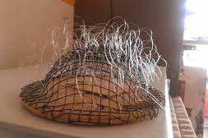
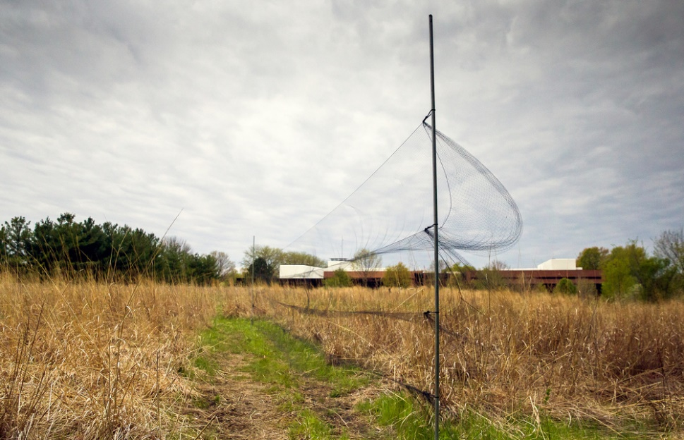
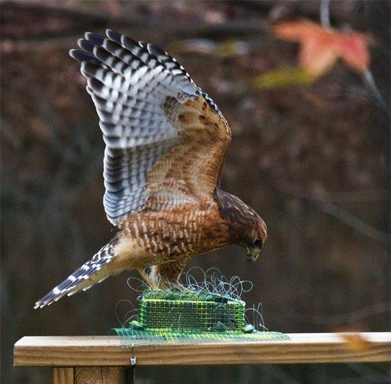

Mist Nets
Bal Chatri Trap

Slide 7
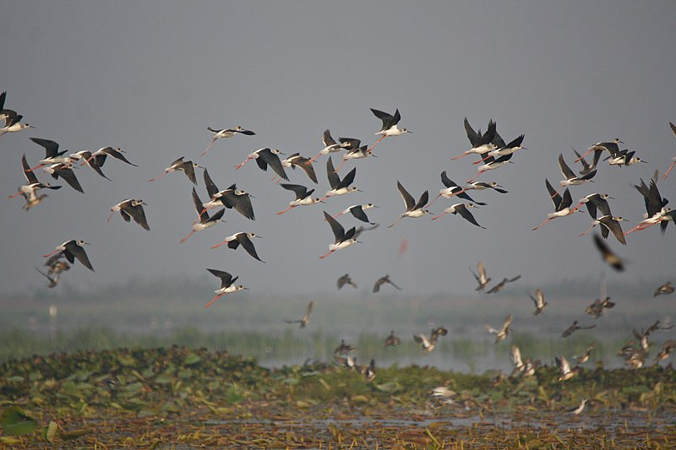
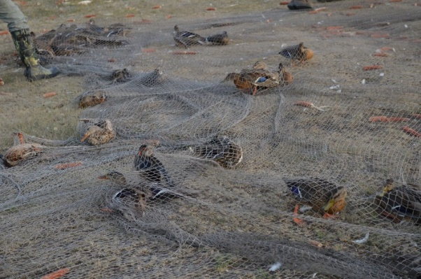
Designing wildlife surveys
Tie surveys to your objectives
Maximize the ability to get useful data
Use methods that are most effective for your target species
Survey during times and dates of greatest activity
Make sure your surveys can answer your questions
Power analysis
Appropriate spatial and temporal coverage
Good data management
Clear datasheets to record all relevant data
Plan for long-term data storage- never want to throw data away!!!

Slide 8
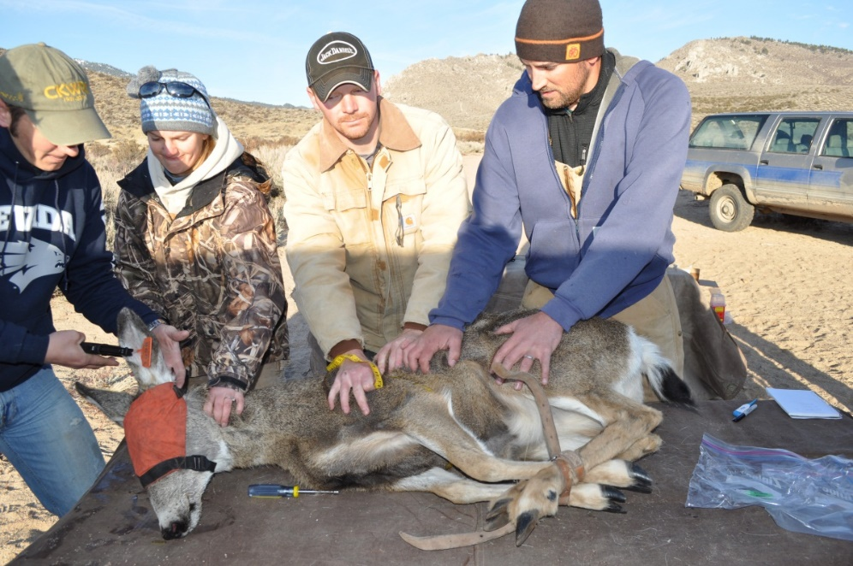
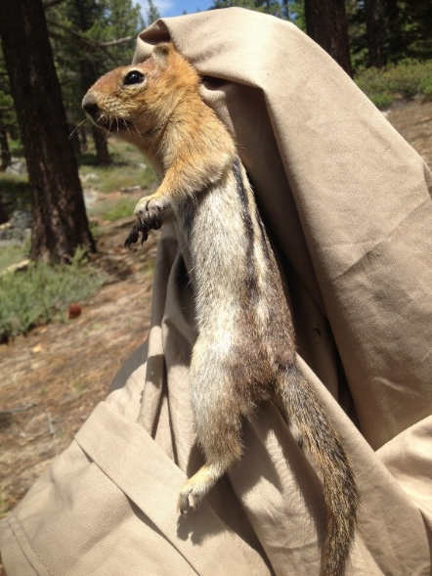
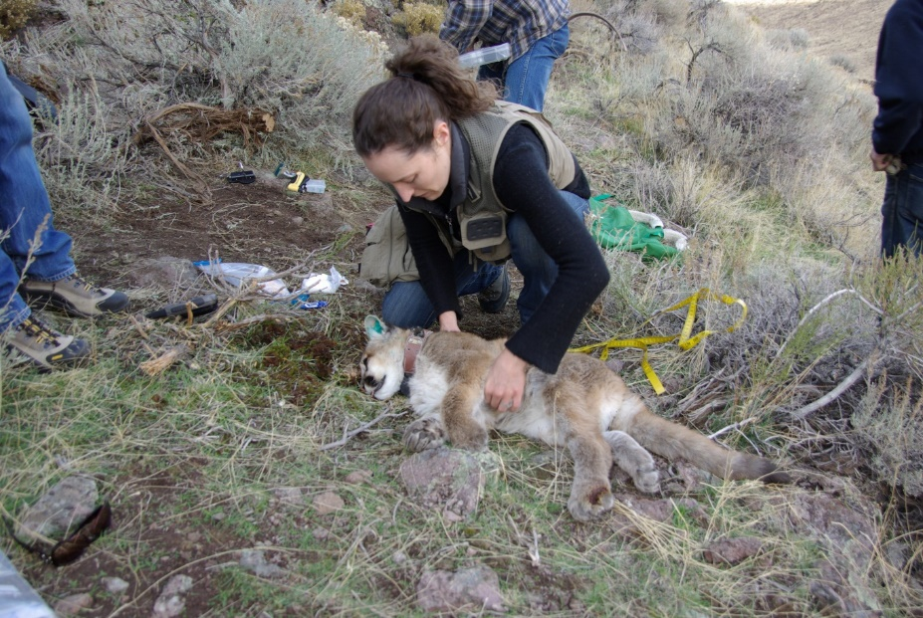
Capture and handling considerations
Do you really need to capture them at all?
What affect might capture and marking have on survival or behavior?
Handling safety of animals
How long will it take to handle each animal?
How can we minimize risk of injury?
Safety of people!
Minimize injury risks
Direct: Bites, kicks, horns, sharp bills, etc
Indirect: injuries during capture
Disease transmission

Slide 9
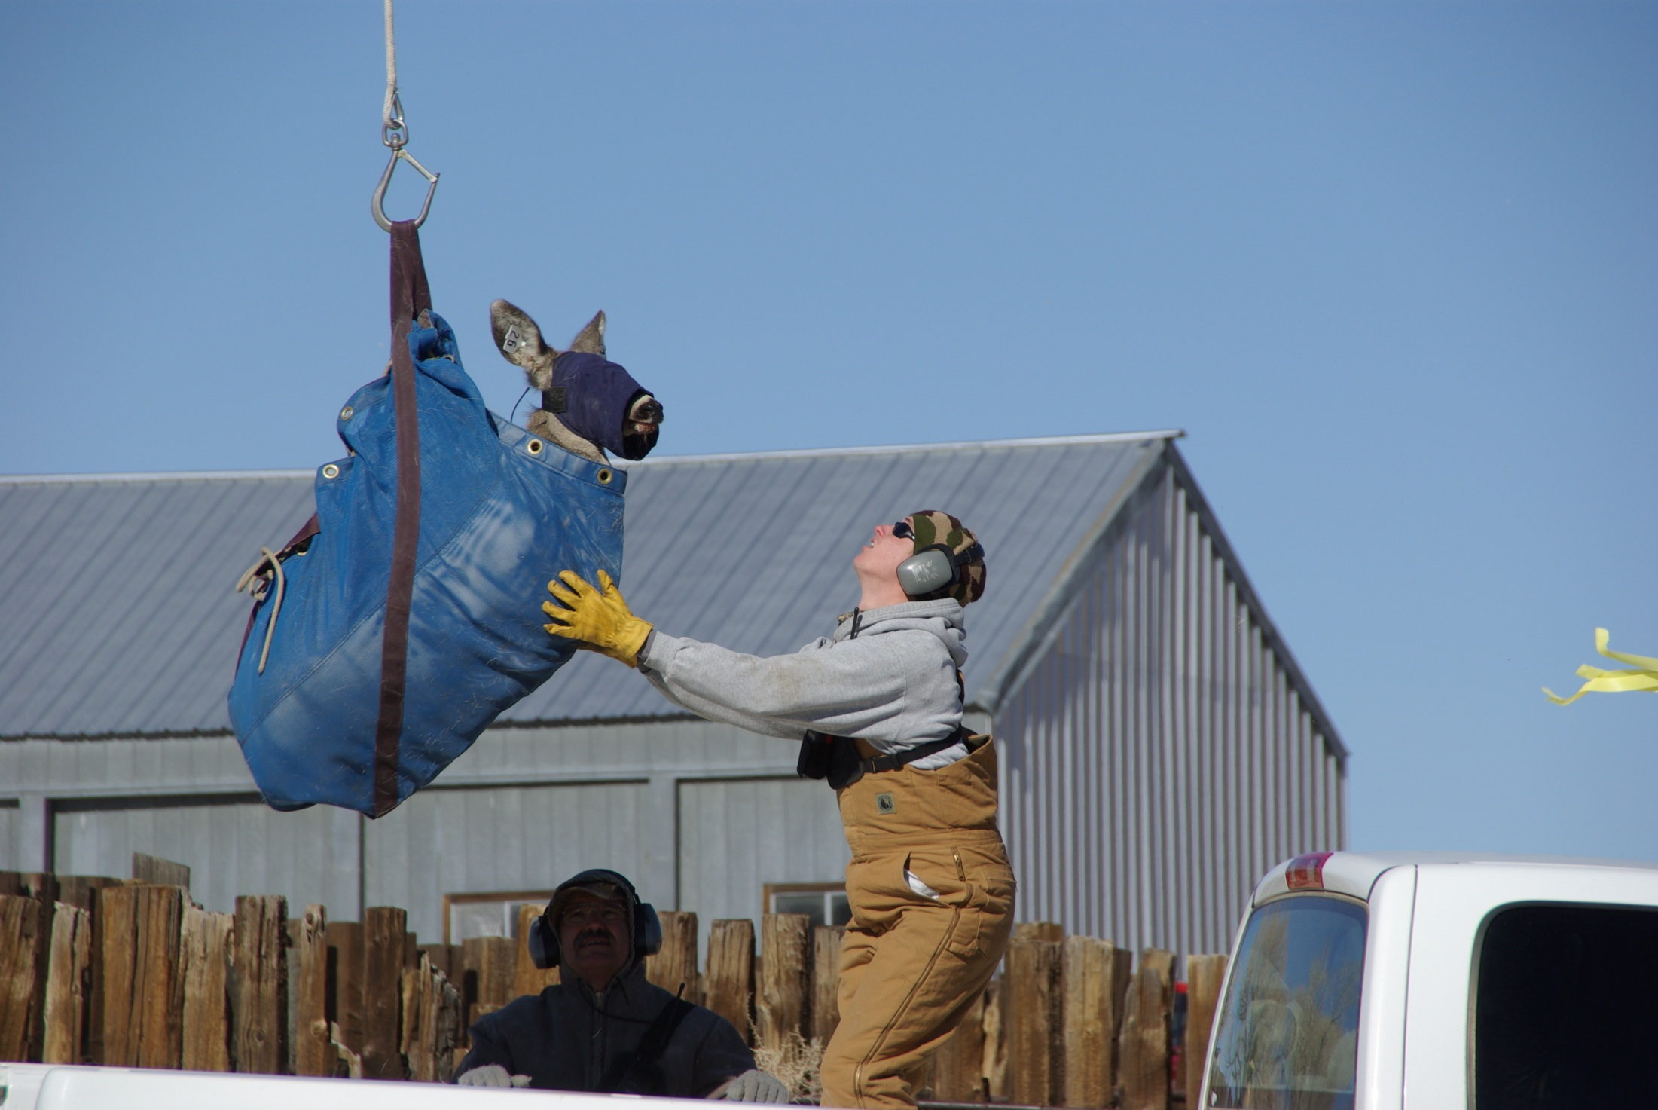

Slide 10
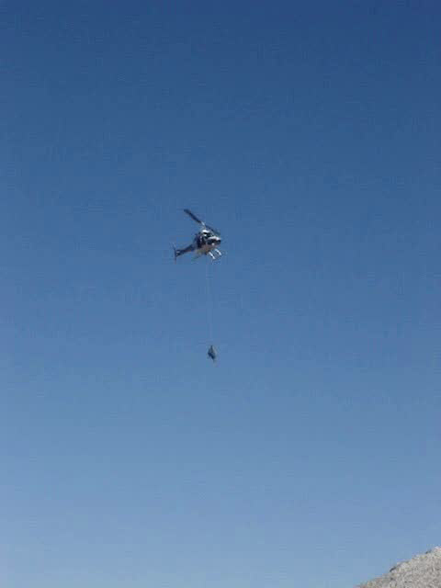

Slide 11
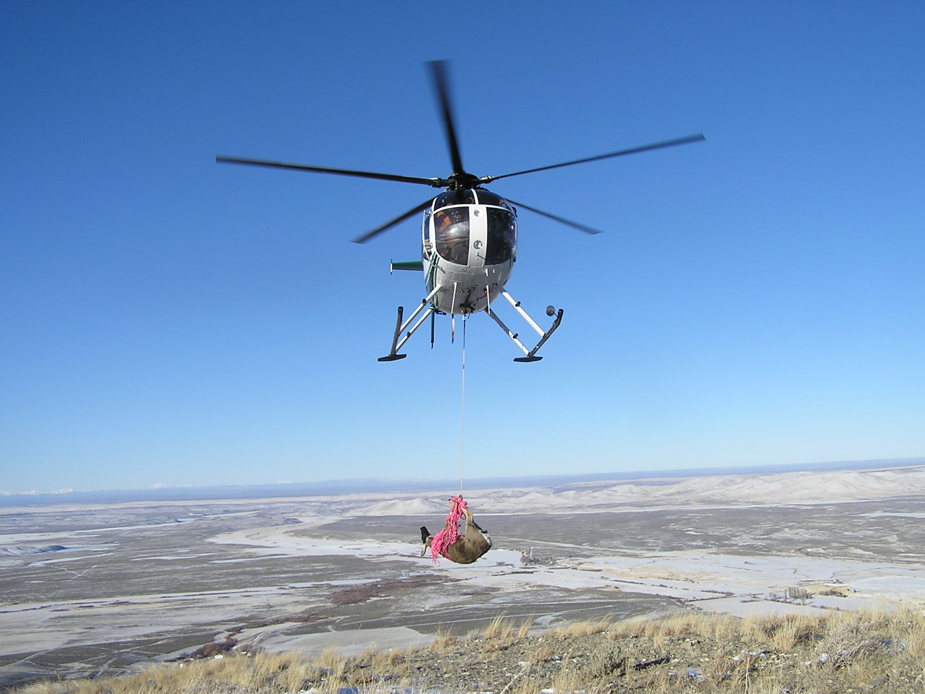

Slide 12
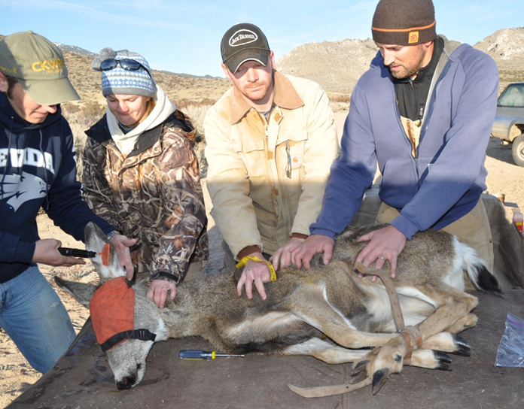
Capture Myopathy
(Exertional or capture myopathy)
Defined as: non-infectious disease of muscles characterized by damage to muscle tissues brought about by physiological changes, usually following extreme exertion, struggle, or stress.

Slide 13
Notes:
CDC wallet card

Slide 14
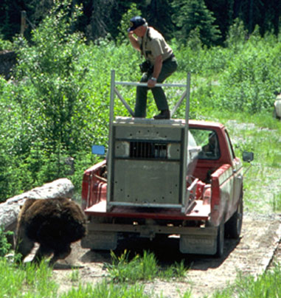
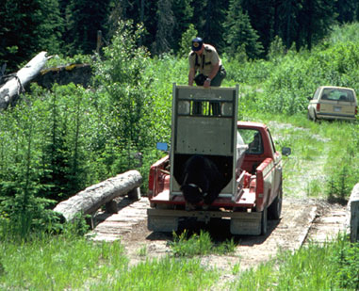
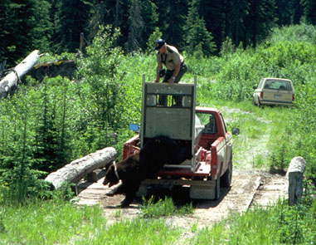
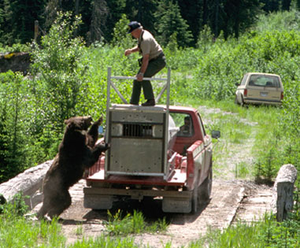
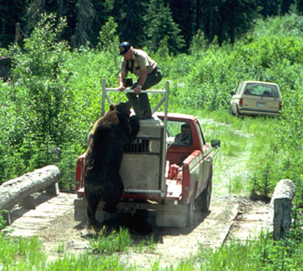
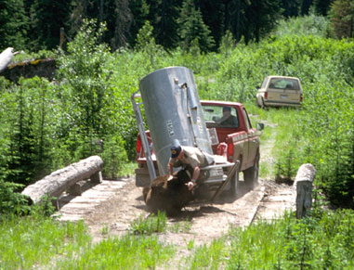

Slide 15
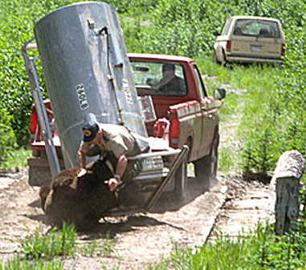
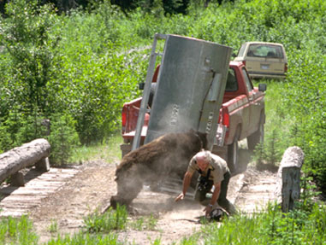
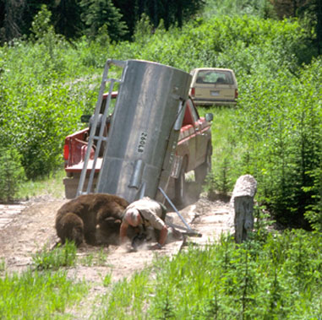
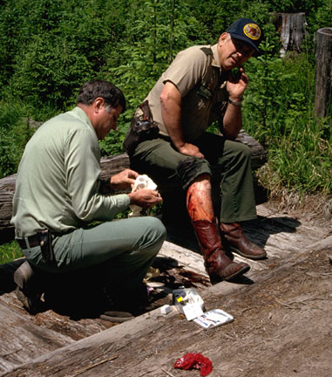

Slide 16
Capture-mark-recapture
Sometimes we NEED to capture and mark animals in order to answer our questions!
Parameters you can obtain with mark-recapture analysis:
Abundance
Survival rate
Recruitment (entry of new individuals into the population)
Lambda (pop. growth rate)
Dispersal rates
Variability and environmental influences on the above

Slide 17
Abundance estimation!
SCENARIO: We capture and mark 10 individuals during our first site visit. Of the 8 individuals captured in our second visit, 4 had been previously marked in the first visit.
Q: Approximately what fraction of the population did we mark during the first site visit?
Q: What is the total abundance?
Q: What if we had only observed 2 (out of 8) marked individuals during the second visit?
Notes:
Everyone wants to know- how many???

Slide 18
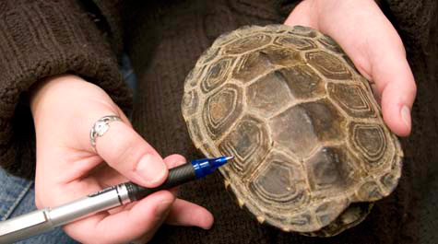
It’s about more than just counting, of course!
Additional data collected once you’ve captured an animal include:
Age (but how do you do this?)
Sex (not always as easy at it sounds)
Reproductive status
Mass, body condition
Health assessment
Unique ID (for recaptures)

Slide 19
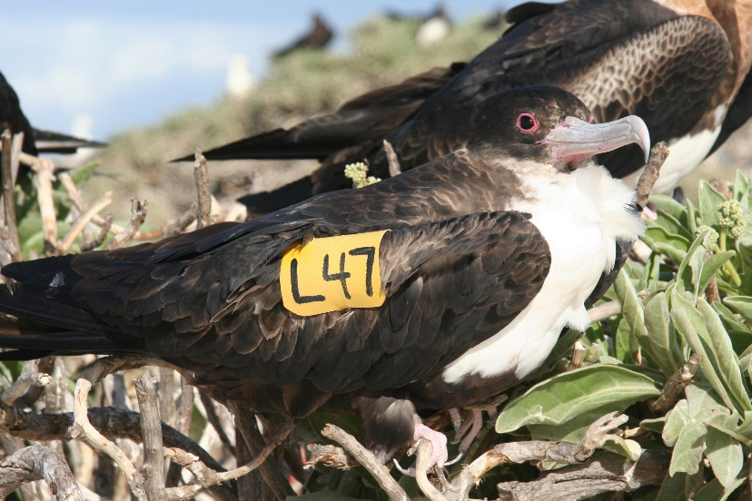
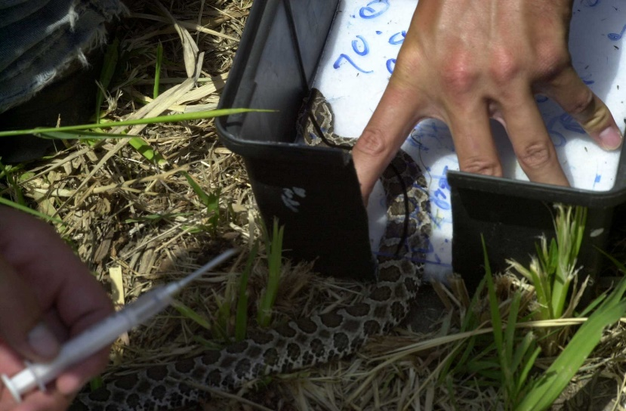
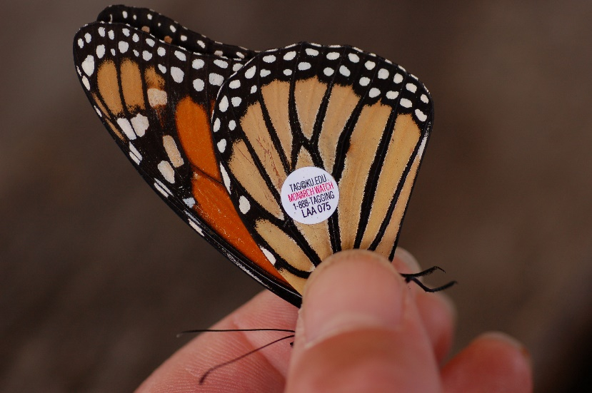
Ways of marking animals
Collars
Leg bands
Ear tags
Branding
Shell notching
PIT tags
Pigments
Toe clipping (ugggh!)
DNA (all animals come pre-marked!)

Slide 20
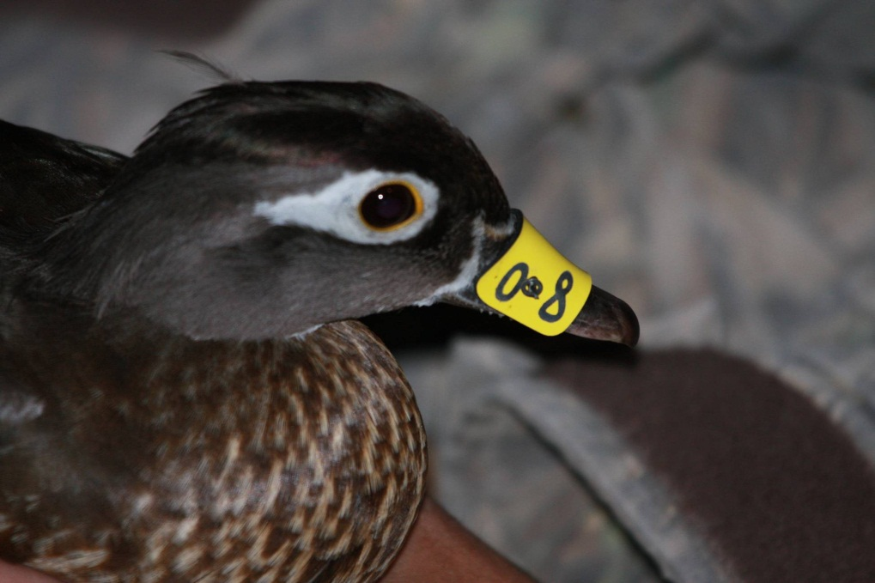
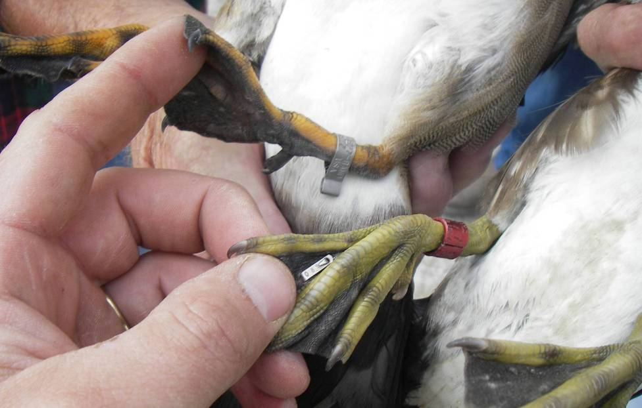
Mark types: two primary categories
Inconspicuous
Require the animal to be recaptured or killed (e.g., hunter recovery) for future identification
Conspicuous
Animal can be identified at a distance

Slide 21
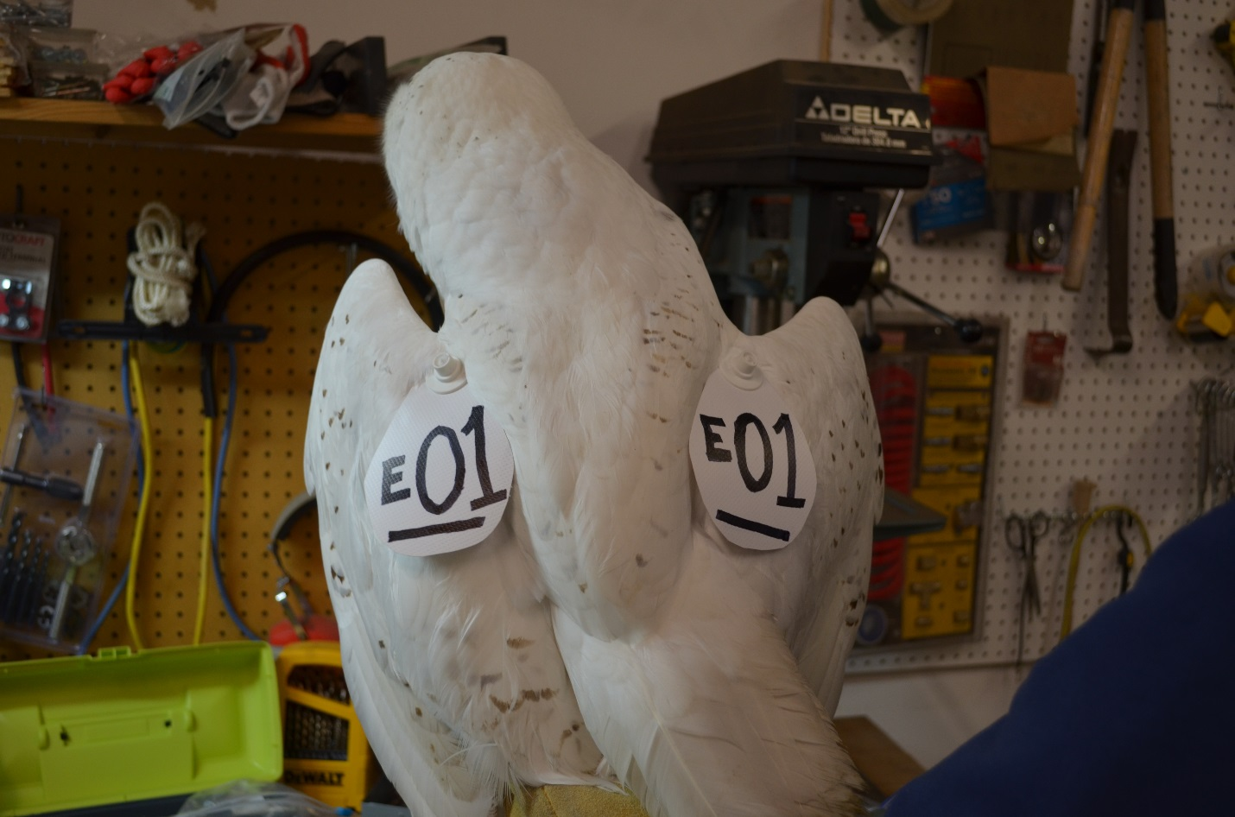
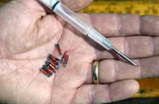
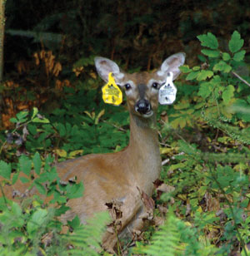
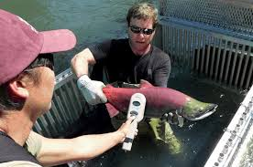
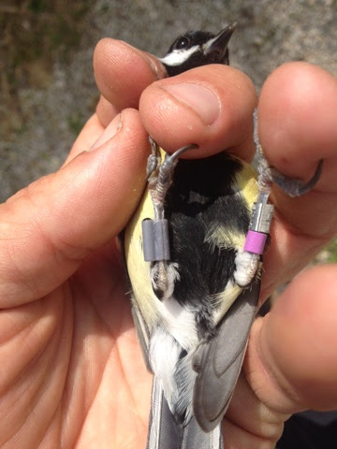
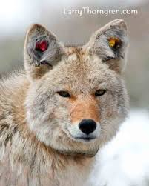
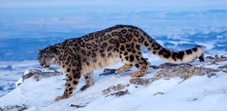

Slide 22
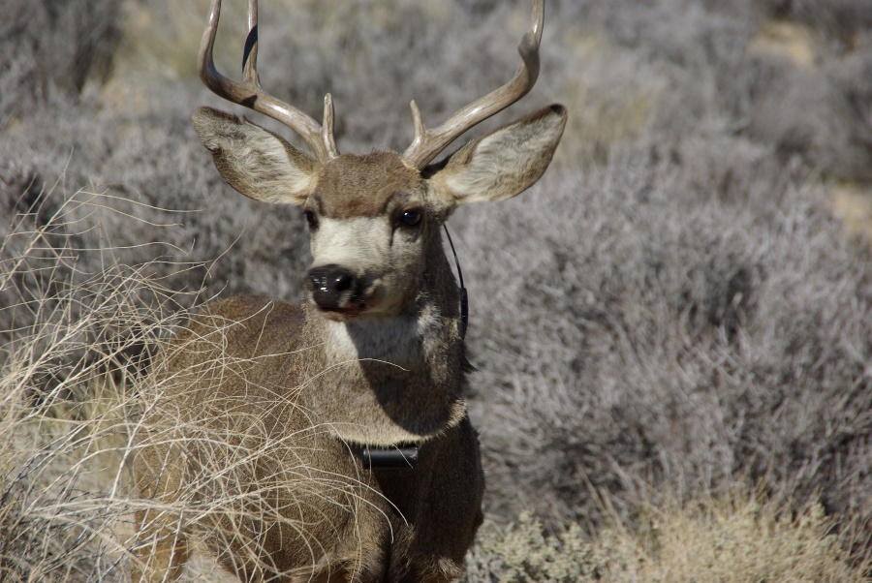
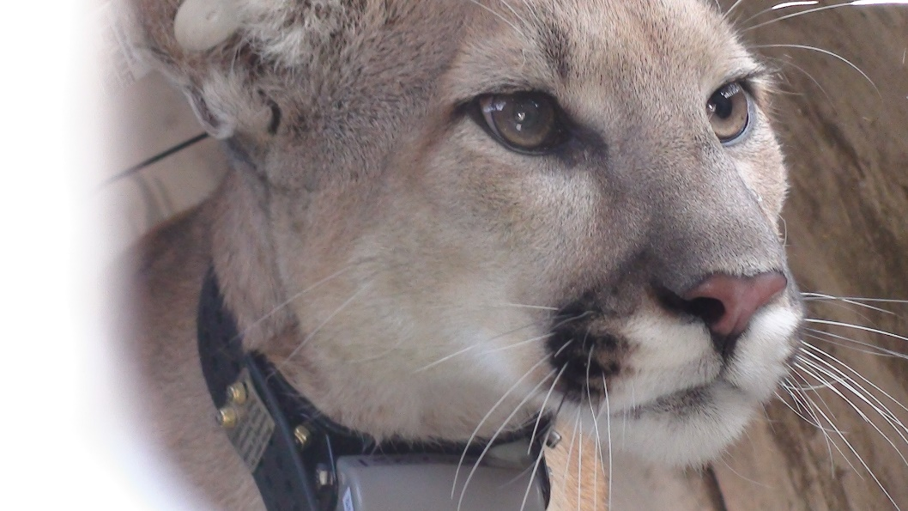
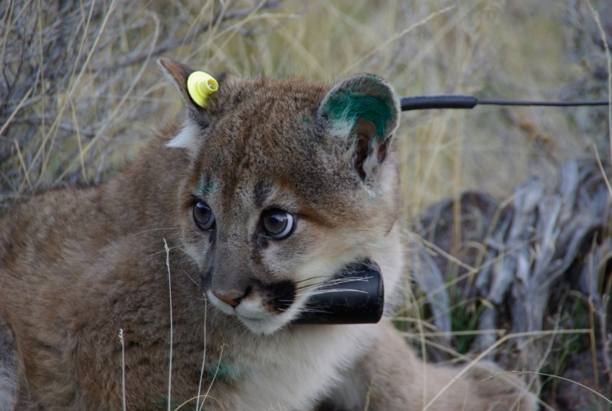
Radio Telemetry: a special type of mark!

Slide 23
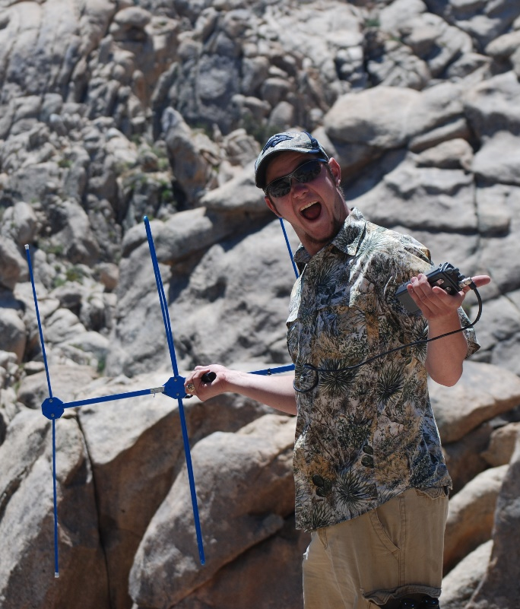
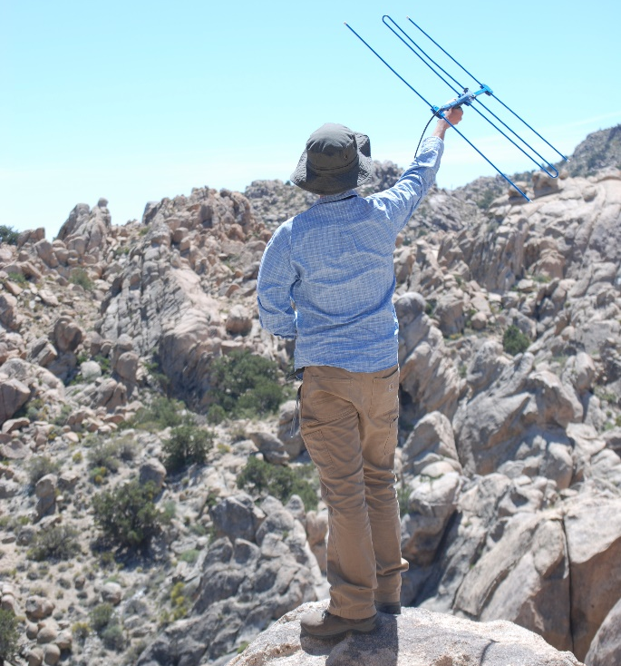
What Is Telemetry
Wildlife radio telemetry can be defined as the transmission of information from a transmitter on a free-ranging animal to a receiver
Each transmitter has a unique frequency (often VHF- Very High Frequency)
Transmitters are placed on (or in) the target animal; researchers can then relocate the individual with a hand-held receiver and one of several types of antenna

Slide 24

Radio Collars
Many different types of collars and ways to collect locations of animals.
Traditional VHF (very high frequency) signals, requires technician to locate animals and determine their locations.
GPS (Global Positioning Systems) can be incorporated into radio collars and use satellites to locate animals
Can be programmed to take multiple numbers of locations in 24/hr period.
Store on board, linked to cell phones, satellite download to computer.
Notes:
Can now track even very small animals

Slide 25
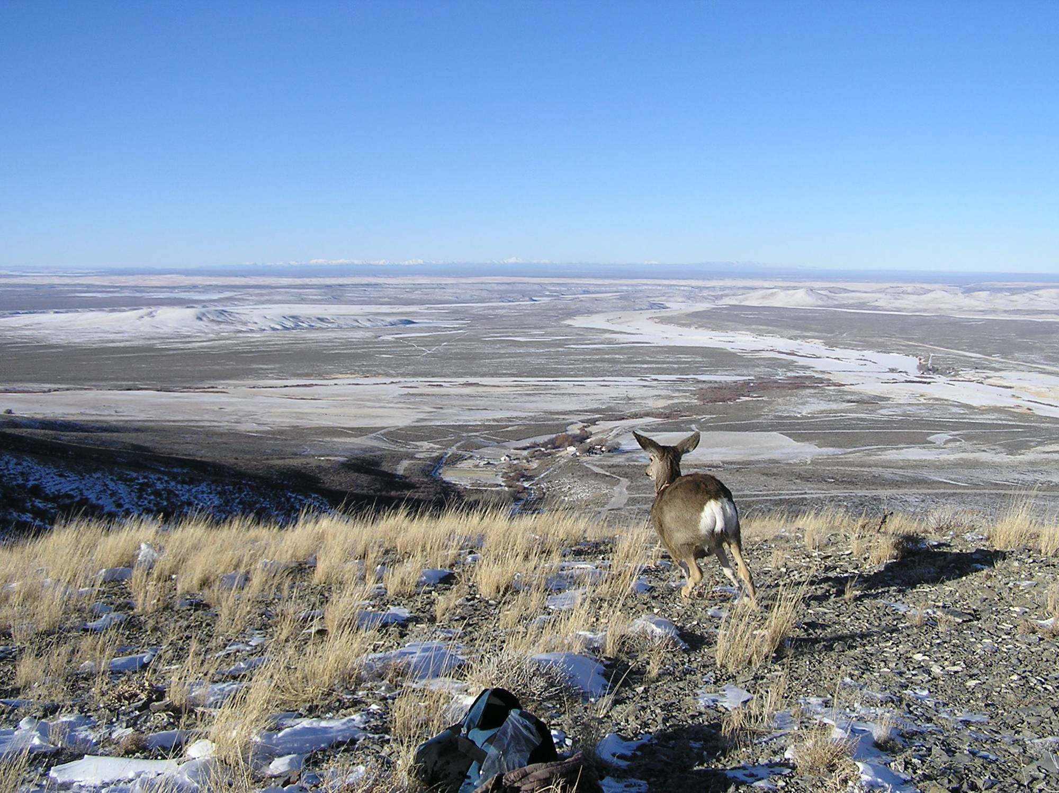
Notes:
How does an animal choose where to go in a broad landscape?

Slide 26
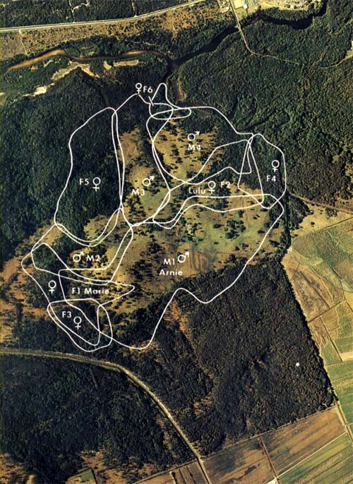

Home Range
Each individual Koala establishes a home range with a set of exclusive trees!
Each polygon is a different koala home range
Imagine a highway going though your living room!
https://www.savethekoala.com/about-koalas/how-koalas-live-socialise-communicate

Slide 27
Quick survey of survey methods for different types of wildlife

Slide 28
Birds and bats

Slide 29


Slide 30


Slide 31


Slide 32


Slide 33




Slide 34



Slide 35


Slide 36





Marking birds and bats

Slide 37
Mammals

Slide 38


Slide 39



Slide 40


Slide 41


Slide 42


Slide 43



Slide 44






Marking and tagging mammals

Slide 45
Amphibians, reptiles, fish

Slide 46


Slide 47


Slide 48


Slide 49


Slide 50



Slide 51


Slide 52







Marking and tagging herps and fish

Slide 53
Invertebrates

Slide 54


Slide 55


Slide 56



Slide 57


Slide 58


Marking and tagging invertebrates

Slide 59


So you have surveyed some wildlife… Now what?
Estimate population size
Mark-recapture analysis
Distance sampling, etc.
Estimate population trends/fitness
Survival, fecundity
Multiple abundance estimates over time
Occupancy models
Predict the future
Population modeling
Assess habitat suitability
Where are they most likely to occur
Where are they most abundant
Notes:
Lots of specialized statistical methods for dealing with incomplete detection.

Slide 60






Questions?

Slide 62
What Is Telemetry
New advances in the field of telemetry make it possible to acquire detailed data on:
Habitat use
Home range
Survival / mortality
Migration corridors
Radio telemetry can be used on a wide assortment of animals
Mammals, birds, reptiles, amphibians, and even insects
Can accommodate animals as large as whales or as small as Bees

